Slide 1



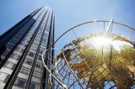


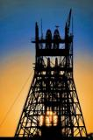
Siemens AG
Strategy Discussion
November 3, 2017

Slide 2

Contents
Section |  | Page
1. | Why Siemens AG? | 2
2. | Detailed Company Analysis | 6
3. | Income Outlook | 13
4. | Facility Analysis | 14
5. | What are We Doing Well? | 15
6. | Opportunity Outlook | 16
7. | CST Client Strategy | 17
8. | Conclusion | 21

Slide 3
Why Siemens AG?
Siemens AG’s strategic alignment with SBSA’s competencies
Solid business fundamentals for SBG: ROE of 148% and CROC of 371%
One of the largest technology companies in the world, with a market capitalization of: €105bn and revenue of €83bn
Sound financials: ROE of 2.2 (av.), EBITDA of €10.2bn
SBG is Siemens’ Transactional bank in 9 SSA countries
Perfect fit with SBG’s strategy of supporting global companies into Africa (presence in 13 African countries)
Listed on Germany’s Frankfurt am Main and Xetra = Meeting rigorous listing requirements
Expected significant income growth rate of min. 69% for SBG in 2017
2017 annualized revenue of R71.6m vs. 2017 Budget of R40.6m

Slide 4
Why Siemens AG?
A global technology company with significant African ambition
Siemens AG (“Siemens” or "the Company"), headquartered in Munich and rated rated SB06 on a stand-alone basis, is one of the largest technology companies in the world, with core activities in the following reportable segments:
Power and Gas: Siemens’ second-biggest business line after healthcare, spectrum of products and solutions for generating electricity from fossil fuels and for producing and transporting oil and gas (e.g. turbines, instrumentation and control systems etc.). Contributed to 21% of its revenue in 2016. This remains a focus post the FY16 results, with contract wins including the supply of steam turbines in Kuwait, the supply of gas turbines worth USD400mn in Saudi Arabia and a partnership with EDF as wind turbine supplier for IPP projects in Belgium.
Wind Power and Renewables: Design, manufacturing and installation of wind turbines
Power Generation: Services offer covering performance enhancements, maintenance services, customer training and professional consulting
Energy Management: Services related to the transition and distribution functions
Building Technologies: Provision of automation technologies and digital services for buildings. Factory automation is an increasingly attractive business, with countries such as China targeting rapid growth in domestically manufactured goods
Mobility: Passenger and freight transportation, including rail vehicles, rail automation systems, rail electrification systems and road traffic technology
Digital Factory: Supply of system solutions used in manufacturing industries
Process Industries and Drives: Supply of product, software, solution and service portfolio for machinery and other installations
Healthineers: Siemens’ €40bn healthcare business supplies technology to the healthcare industry as well as medical imaging and laboratory diagnostics
Listed on Germany’s Frankfurt am Main and Xetra, thereby satisfying both exchanges' rigorous listing requirements
In 2017, the Company’s market capitalization and revenue are estimated at approx. $122.9bn and $96.8bn respectively
Global footprint with presence in Latin America, Middle East, Asia and Africa
Siemens has a presence in 13 African countries, with SBG currently being its main transactional bank
Number of employees estimated at 351,000
Significant investments being made across multiple regions, including Africa
Listed on Germany’s Frankfurt am Main and Xetra
Market cap of $122.9bn with net revenue estimated at approx. $2.8bn
Presence in 13 African countries, including South Africa

Slide 5
Why Siemens AG?
Corporate structure: African footprint
The Group provides implicit support for their subsidiaries under a Global Letter of Support.…
Siemens AG
51%
?%
90%
?%
?%
95%
100%
100%
70-100%
100%
North Africa
Angola
Cote d’Ivoire*
Ghana
Kenya
Malawi
Mozambique
Namibia**
Nigeria
South Africa
Tanzania
Algeria
Siemens S.A., Luanda
Siemens CIV, Abidjan
Siemens Oil & Gas Equipment Limited
Siemens Kenya Ltd., Nairobi
Siemens Malawi
Siemens Limitada
Siemens Pty. Ltd., Windhoek
Dresser-Rand (Nigeria) Limited, Lagos
Dresser-Rand Property (Pty) Ltd., 100%
Siemens Tanzania Ltd
Egypt
Dresser-Rand Service Centre (Pty) Ltd, 100%
Tunisia
Siemens Ltd., Lagos
Morocco
Dresser-Rand Southern Africa (Pty) Ltd, 100%
Standard Bank presence countries
Linacre Investments (Pty) Ltd, 0%
Non-presence countries
Siemens Healthcare Proprietary Limited, 100%
%
Stake in the subsidiary
*
Recently opened subsidiary
Siemens*** Proprietary Limited, 70%
**
Liquidation process was finalised in the current financial year
Siemens Wind Power
0
Crabtree South Africa (Pty) Ltd, 100%

Slide 6

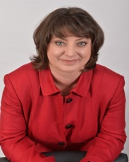

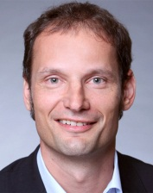

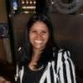
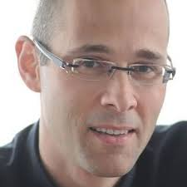
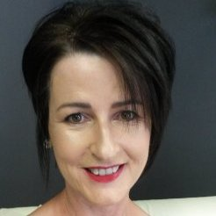
Why Siemens AG?
Key management and relationships
Standard Bank has established key relationships at all levels of Siemens’ decision making process
CC: Udo Raab
RM: Jeannot Boussougouth
IB Champion:
David Veale
Credit Champions:
Evan Watts
Reshana Maharaj
TPS Champions:
Stella Evbuomwan
Thendo Mulaudzi
Power Sector Head:
Rentia van Tonder
Global Markets Champions:
John Beynon
Charmaine Vorster
Executive Sponsor:
Stephen Barnes
Sim Tshabalala
Stephen Barnes
Udo Raab
Jeannot Boussougouth
Joe Kaeser – President and CEO
Sabine Dall’Omo – CEO, Siemens SA
Udo Raab
Jason Marsden
Udo Raab
Charmaine Vorster
Jeannot Boussougouth
Ralf Thomas – CFO
Siemens AG
Stephan Mueller – CFO, Siemens SA
Udo Raab
Jeannot Boussougouth
Charmaine Vorster
Klaus Helmrich – EMEA, Siemens AG
Melinda Godden – Head of Banking, Siemens SA
Udo Raab
Evan Watts
Jeannot Boussougouth
Charmaine Vorster Thendo Mulaudzi
Stefan Stitzl – Head of Treasury Siemens AG
Adriana Brink – Treasury Accountant, Siemens SA

Slide 7



Detailed Company analysis
Peer group comparison*
The EMEA region accounts for 52% of its total revenue (followed by Americas at 29%)…
Source: Capital IQ
*As at Sep 2015
Sub-segments
Power Suite
Mobility
Healthcare
…Suitable level of gearing and leverage ($36.4bn) given the asset intensive nature of the business…
Revenue (In €m) | 24.7 | 117.8 | 32.2 | 79.6
Revenue Growth Rate (In €m) | -7.3 | 5.1 | -3.4 | 5.3
Equity (In €m) | 20.7 | 73.8 | 13.2 | 34.8
Total Debt/EBITDA | 2.0 | 7.1 | 1.7 | 2.8
Total Debt/Equity | 0.4 | 1.8 | 0.5 | 0.9
Net Debt/EBITDA | 1.3 | 4.6 | 0.8 | 1.8
Net Debt/Equity | 0.2 | 1.1 | 0.2 | 0.6
…The take-on of value creating debt supports the Company in executing its long term strategy
Strategically, Siemens appears to be whittling down from a sprawling conglomerate into a more focused producer of industrial goods, granting its non-core units more autonomy by:
Spinning off its healthcare unit, which could boast a market value of approx. $46.7bn;
Merging its rail business with France’s Alstom SA into Siemens Alstom (combined sales of $17.9 bn), a JV in which Siemens will own a 50% plus a few additional shares. The objective is to help withstand the international advance of China's state-owned CRRC Corp Ltd. (annual revenue of about $35bn). The deal is expected to be concluded by the end of 2018;
Having merged its wind power division with Spain’s Gamesa to form Siemens Gamesa, the world’s second-largest maker of wind turbines after Denmark’s Vestas (with Siemens holding a 59% stake in the JV). The company is publicly listed on Bolsa de Madrid.
0

Slide 8
Detailed Company analysis (Contd…)
SWOT analysis
Strengths
Weaknesses
Large product and service portfolio
Significant appetite for African risks
Excellent project execution due to a continuous reduction in non-conformance costs
On-time delivery of projects and solutions
Robust financial position
Long-term investment horizon
Track record of operating in Africa
Strong after-sales and support
Higher cost structure compared to new entrants from Asia
Until recently, inability to provide fresh capital to projects
Expected restructuring of its Power and Gas business line (40% drop in profits in 2017) due to overcapacity and falling prices
Potentially high severance charges due to the expected reduction of human capital at its Power and Gas business and Siemens Gamesa Renewable Energy
Continuous high demand for power across Africa
Strengthening key segments through portfolio measures (e.g. Crabtree acquisition)
Recent ability to provide equity in projects with a view to securing equipment supply contracts
Solid economic growth
Highly competitive environment (pricing, product quality, financing terms etc.)
Shifts in market demands, with a steady decline in demand for large turbines used in power plants
Expected steady decline in power-plant turbine demand during the period between 2018 and 2020 (from 249 in 2011 to 111 annually on average)
Strong competitors from emerging markets (e.g. China), with better cost structures
Challenging financial position of utilities across Africa
Delay in the award of SA’s REIPPP
Dollar liquidity constraints in key markets
Opportunities
Threats

Slide 9
Detailed Company analysis (Contd…)
Client segment and products analysis
Primary Business focus: A comprehensive portfolio of power products and services
S-Curve
Power portfolio | Key characteristics | Customer segments
1. Turbine |  | Chemicals | Cement | Metals and Mining | Public utilities | IPPs | O&G | Sugar mills | Pulp & Paper
Steam | Up to 1.9GW | √ |  |  | √ | √ | √ | √ | √
Gas | 4 to 564MW | √ | √ | √ | √ | √
Wind | Onshore and offshore |  |  |  | √ | √
2. Generators | Up to 2,235MVA | √ | √ | √ | √ | √ | √ | √ | √
3. Engines
Gas | - | √ | √ | √ | √ | √ | √ | √ | √
Diesel | - | √ | √ | √ | √ | √ | √ | √ | √
4. O&M/EPC | Turnkey solutions | √ | √ | √ | √ | √ | √ | √ | √
5. Power Transmission
HV substations | - |  |  |  | √ | √
Transformers | All types. Up to 1,000MVA |  |  |  | √ | √
Overhead lines | - |  |  |  | √ | √
6. Small hydro | Up to 30MW |  |  |  | √ | √
7. Hybrid Power
Diesel/PV or Wind) | With or without electrical or thermal storage | √ | √ | √ | √ | √ | √ | √ | √
Traditional power products and service under intense competitive pressure
Despite the above, Siemens is facing an increasingly competitive market for both its Power & Gas and Wind & Renewables businesses:
Increasingly stringent environmental regulations (e.g. COP21) restrict ability to provide steam turbines to coal power projects;
Heavy dependence on financial strength of utilities;
Demand for large power-plant turbines expected to continue to decrease within the next 3 years, from an annual average of 249 in 2011 to 111);
Downturn in India, which is in transition from being a subsidized market to an auction-led one leading to more competition and pressure on wind turbine prices.
0
0

Slide 10
Detailed Company analysis (Contd…)
Client segment and products analysis (Contd…)
Disruptive Business: Healthineers
S-Curve
Healthcare portfolio | Key characteristics | Customer segments
1. Medical Imaging | Main usage encompasses diagnostics, prevention and therapy | Primary care provider | Specialty care
2.Laboratory diagnostics | Broad spectrum of systems and services | √ | √
3. Point-of-Care Testing | Provision of immediate, convenient, and easy-to-use diagnostic testing | √ | √
4. Healthcare IT | Including eHealth Solutions | √ | √
5. Services |  |  | √
Customer services | -
Enterprise Services | -
Laboratory diagnostics services | -
6. Accessories, OEM & Electronics | Offers carefully selected accessories for Siemens Healthineers modalities and clinical applications | √ | √
7. Refurbished Systems |  | √ | √
The global healthcare market is currently shifting focus from Siemens’ core business of imaging to molecular diagnosis and patient self-management
As such, Siemens has recently mandated Goldman Sachs, Deutsche Bank and JP Morgan as lead organizers of an IPO for its Healthineers unit, the biggest contributor to Siemens’ third-quarter profit with a 1% increase to approx. €702m (or $819m), and which could be valued at up to €40bn (or $46.7bn). It is not yet clear what impacts this would have on its African business
This IPO is expected to enable Siemens to do share deals when looking at future acquisitions. The company recently acquired the Epocal business from Abbott, which will be integrated into the Siemens Healthineers’ POC Ecosystem portfolio
In Africa, it should be noted that the healthcare business only reported its first full year operations as a stand-alone entity at the end of 2016, given that the company was previously a division of Siemens (Pty) Ltd
In 2016, the company generated revenue estimated at approx. R1.3bn, whilst posting a solid EBITDA of R142.2m. The business has no debt
Market shifts to molecular diagnosis and patient self-management
0
0

Slide 11
Detailed Company analysis (Contd…)
DuPont analysis – Siemens Proprietary Limited (“SPL”) (As at Sep 30, 2016)
Category | Formula | 2015 | 2016
Profitability (1) | PAT/Revenue | -11 | 10
Activity (2) | Revenue/Net assets | -12.4 | 22.1
RONA (in %) | (1) * (2) | 1.39 | 2.25
ROE (in %) | - | 1.4 | 2.2
Revenue (R bn) | - | 6.3 | 9.1
EBIT (R bn) | - | 0.9 | 1.3
Total assets (3) (R bn) | - | 3.9 | 3.8
Total liabilities (4) (R bn) | - | 4.4 | 3.4
Net assets (R bn) | (3) – (4) | -0.5 | 0.4
PAT (R bn) | - | (0.7) | 0.9
Retained earnings (R bn) | - | (0.5) | 0.4
Siemens Proprietary Limited: Group and Company Annual Financial Statements for the year ended 30 September 2016
Sources: Siemens Proprietary Limited, Standard Bank

Slide 12
Detailed Company analysis (Contd…)
Profitability (In %)
Activity (In %)
SPL‘s profitability rebounded to 10% at Group level, thereby demonstrating how relatively good it was at converting revenue into profits available for shareholders…
10%
22.1%
“Siemens’ asset usage has dramatically improved since 2015
>
Growth analysis:
RONA vs. ROE
…Demonstrable ability to continuously generate profits from its shareholders’ investments with an ROE of 22.1% in 2016…
…Improved management performance with a positive RONA of 2.25…
Negative growth rates due to a combination of either negative retained earnings (-R0.52bn) or negative equity (-R0.51bn) during the previous year (2015)
The above was triggered by the since-reversed R1.2bn initial loss provision raised by the Company for the Kusile power project in SA
Between 2015 and 2016, Siemens' RONA increased from 1.39 to 2.25, indicating that its profitability and financial performance has been steadily improving
This also demonstrates how effectively and efficiently Siemens is using its assets to generate earnings

Slide 13
Income analysis: Siemens, a key client for SBG’s P&I franchise
Income generated per presence country (In Rm)
R21.7m
In 2016, SBG generated approx. R42.3m in income from its banking activities with Siemens across Africa
SA remains the most important cash generating center, accounting for approx. 51.3% of the total revenue in 2016
In terms of products, TPS accounted for 74% of the total revenue, at R31.4m
This split is likely to remain as we ramp up account opening processes across markets such as South Africa and Uganda etc.
In 2016, SBG generated approx. R42.3m in income from its banking activities with Siemens…
Income (Rm)
…SA accounted for approx. 51.3% of our 2016 total income…
SBSA Facilities extended to Siemens (Pty) Ltd
Excluding combined trading and payment settlements of R3.15bn, our total limits are currently estimated at approx. R1.7bn
Overall, SBG facilities more than doubled over the past 4 years
Performance guarantees as well as working capital facilities currently account for 52% and 26% of the total facility limits respectively
We anticipate an increase in working capital needs given Siemens’ recent acquisition of Crabtree
Type of Facility | Limit (R) | Current Exposure (R)
Credit Card | 1 000 000 | -
Vehicle And Asset Finance | 8 500 000 | 466 839
Performance Guarantees | 863 500 000 | 459 273 063
Financial Guarantees | 127 500 000 | -
Working Capital Facilities | 430 500 000 | 280 000 000
LC | 9 000 000 | -
Pre-Settlement | 225 000 000 | 29 666 172
Total SBSA | 1 665 000 000 | 769 406 074
…Significant headroom available with only R0.9bn having been utilized to date

Slide 14
Income analysis: Siemens, a key client for SBG’s P&I franchise (Contd…)
Overall income (As at September 30, 2017)
As at September 30, total income was estimated at R53.7m
This has primarily been driven by TPS, whose revenue increased by a whopping 56% y-o-y
From an operational perspective, the strategic alignment between the various SBG’s in-country teams (Africa and Europe) is expected to help further drive accountability and renewed focus in our approach to Siemens
It should also be noted that this approach has partially been driven by the fact that most regions (excluding West Francophone Africa) are now reporting into Siemens South Africa, with Treasury requiring a single point of contact within SBSA
As at September 30, total income is estimated at approx. R53.7m…
R46.7m
+56% increase year-on-year as at Sept. 30
Income (Rm)
…At this rate, 2017 annualized figure to reach R71.6m…
R6.9m
R0.07m
We believe that connecting the operational CST across our different regions will help fast track turnaround on requests
A collective effort has been made this year to lead the regional teams towards a more collaborative approach
Yet revenue derived from IB still remains limited, primarily due the intrinsic nature of OEMs in general (e.g. limited term-lending opportunities)
However, given that Siemens’ growing challenge is the need to provide alternative financing solutions to projects they are tendering, we have started to focus more on Project Finance (See slide 16)
…The 2018 budgeted revenue is approx. R72m
Income (Rm)

Slide 15
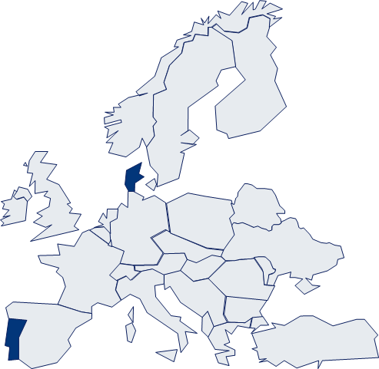
Facility analysis: Overview of SBG’s facility limits extended to Siemens AG
Facility Overview
Siemens Oil & Gas Equipment Limited: R0.025bn
Siemens Ltd: R0.056bn
1
9
Siemens S.A: R0.14bn
2
Siemens WindPower Denmark: R0.042bn
3
Siemens Limitada: R0.08bn
8
Siemens WindPower: R0.2bn
7
Siemens Healthcare: R0.09bn
6
Siemens (Pty) Ltd: R1.67bn
5
Siemens Portugal: R0.046bn
4

Slide 16
What are we doing well?
SBG strives to meet Siemens’ overall financing needs
Action Item |  | Client Need | Desired Outcome
Host-to-Host implementation for Siemens AG |  | The host-to-host implementation for Siemens AG serves a critical need of centralising treasury management at center This is critical for governance and liquidity management for Siemens | The implementation is a lengthy and costly exercise. The desired outcome achieved is increased switching costs if the client were to consider a new cash management bank in Africa. This however does not eliminate the risk as SBSA is not part of the global syndication banks
Roll out of working capital facilities in the following regions:
Angola Ghana Kenya Malawi Mozambique Zambia Zimbabwe | $15m $1m $7.6m €4.5m $14.1m $1m $1m | With certain regions now reporting into Siemens Proprietary Limited in South Africa, the responsibility now lies with the South Africa-based treasury to manage liquidity and foreign exchange risk in those regions | The restructure has opened the doors for SBG to bank Siemens in these new markets There is a need to coordinate and educate the In-Country SBG teams about Siemens operating model and Parent Support policy, particularly In-country Credit
New Siemens Healthcare subsidiary New facilities – R80m New cash management implementation |  | The Siemens Healthcare business is non-core to the Group. However, it remains one of the more profitable The business has been carved out as a stand-alone subsidiary. This created the need for the new business to raise its own facilities and banking platform | The CST successfully rolled out facilities to the new entity and assisted the client with a new cash management profile, demonstrating that we are still the first point of contact Siemens has also recently acquired US-based Dresser Rand in a $7.6bn deal. We will be rolling out the integration across the African regions
Connecting the operational CSTs across the different regions |  | There is a greater need from the client to fast track turnaround on requests The need to feel that they are dealing with one bank across the regions is of great importance and this has not always been the case historically | A collective effort has been made this year to lead the regional teams towards a more collaborative approach. Examples include; Bi-monthly operational CSTs during which all RMs discuss their initiatives and associated opportunities in their respective country Consolidation of the KYC processes across SSA from South Africa Roll-out/Adoption of the Facility Agreement/ Framework with Siemens AG across our presence countries (Ongoing) Introduction of the Global Transactional Banker model
Dual coverage between Johannesburg and Germany |  | There is a natural need for Germany to have the reassurance that they have the full support of SBG for their African operations | Udo continues to play an important role in this regard Jeannot, based in Johannesburg, is the RM for Siemens AG
Strengthening the coverage team to close the lag on IB opportunities |  | Siemens’ growing challenge is the need to provide alternative financing solutions to projects they are tendering, particularly in the energy cluster | As MCC, Jeannot has also been tasked with the responsibility of building our capacity in this space (e.g. Namibia, Uganda etc.)

Slide 17
Opportunity outlook
Potential revenue outlook derived from SBG’s engagement with Siemens
Uganda
Project E
Estimated capex: $4m
Opportunity:
MLA (Proposal submitted)
Account opening
5
Cote d’Ivoire
Project A
Estimated capex: $1.4bn
Siemens:
Equity participation (TBD)
Turbine supply contract
Opportunity
Performance guarantee? (SocGen’s likely competition)
1
Mozambique
Overdraft facility
MZN 100m (or $1.6m)
GBB
MZN 158m (or $2.6m)
Status: Recently secured (Oct. 2017)
4
Namibia
Project B
Estimated capex: $80.3m
Opportunity
MLA (ECA) (Proposal submitted)
2
South Africa
Crabtree South Africa (Pty) Ltd
Account opening – Being completed
$4.8m working capital facility – Proposal discussions to start in November 2017
Healthineers
Project C & D (Credit discussions)
3

Slide 18
CST Client Strategy
1
TPS
Support Siemens with solutions from inception at the business development stage on projects in presence markets
From the bidding process and throughout the lifecycle of each project (e.g. Bid bonds etc.)
Review any offshore issuances of guarantees from competitor banks and facilitate utilization of our lines via SBSA or direct issuance in country where applicable
Ensure appropriate working capital limits are in place to support their plans and growth in each market based on projects being targeted
Get insight into these project from an early stage where possible
Lock in the flows from each project and ensure we are listed as collecting/receiving bank and also subsequently process all payments in country
Ensure TPS flows are captured on any term facilities provided
Support Siemens with their centralization of payment initiative via the EBICS protocol
Given Siemens’ drive to adopt global standards for reporting, support internally closure on the TWIST Billing capability for fee reporting
Continuous focus on key relationship hubs (South Africa) and (Portugal), which are key decision makers in addition to the central team in Germany
Ensure all stakeholders understand the support policy of the group and effectively adopt the framework agreement to facilitate seamless allocation of lines
2
Project Finance
MLA + Hedging roles (depending on risk appetite for counter-parties)
ECA-backed financing structure (to help provide competitive offerings in respect of required quantum of debt, tenor etc.)
Financing of the contract value’s Advance Payment (if required)

Slide 19
CST Client Strategy (Contd…)
3
Global Markets
A key priority for the GM team will be to finalize the long-outstanding ISDA for South Africa, which will then be followed up with those for all other African markets required. The ISDA has been in negotiation for >4 years and we need to put closure on this soonest!
We have made good progress on dealings in Ghana, Namibia, Malawi and see potential in Botswana, Mozambique, Nigeria and Angola as well. It will be crucial to get closer to centers managing the non-SA related Treasury flows (Belgium, Portugal and Germany).
360T has become a real threat given that they are keen to adopt this system and mirror Siemens AG’s use of it going forward resulting in SBG losing ALL flows. There is a strong discussion that is required around the access to liquidity and fact that 360T does NOT equate to a better price – most often it will actually result in a worse price! This has been positioned with Siemens but not as clearly to its Head of Treasury Hub SA! A call to discuss this with Melinda Godden was scheduled but she never joined the meeting although we clearly outlined the pitfalls of pricing on this venue. We have invited further discussions on the same topic.
There is a potential solution to offering 360T to Siemens AG in order to get a shot at pricing their ZAR invoiced flows which are also substantial.
We aim to build a strong relationship with Eileen Bole (Graham), who is known to us from many years working at Sasol – introductions have been made to the dealers.
Siemens has always been very competitive and, as a result, margins are typically very tight. As such, SBG will need to push for both volume as well as flows from markets (Africa) where margins are more meaningful.
Where possible, business needs to be expanded to other Siemens businesses and a relationship with AG needs to be strengthened from an execution perspective. With Michele Maffei and Gareth Hockey now involved in our GM sales effort for MNCs, we MUST push this agenda more aggressively in 2018!
The local treasury in SA may not be as bold and creative as it could be. No structuring thus far but we need to be ready for any large transactions where we can make use of Structures FX and Interest Rate solutions
At any one time, Siemens (Pty) Ltd are typically fully borrowed with Standard Bank and they have been happy with our rates as they are typically the best in the market. We make a decent RoE on these borrowings. Both Siemens Healthineers and Siemens Wind Power place significant deposits with us

Slide 20
CST Client Strategy (Contd…)
4
VAF – Healthineers
VAF formalised its alliance with Siemens in July 2017
We have presented the following solutions to Siemens:
Traditional Finance Partner
Siemens
SBSA
Shared Risk by Guarantee
Agency Arrangement
Full-Recourse Discounting
Subvention Offerings

Slide 21
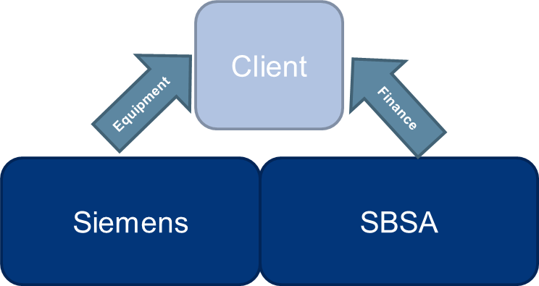
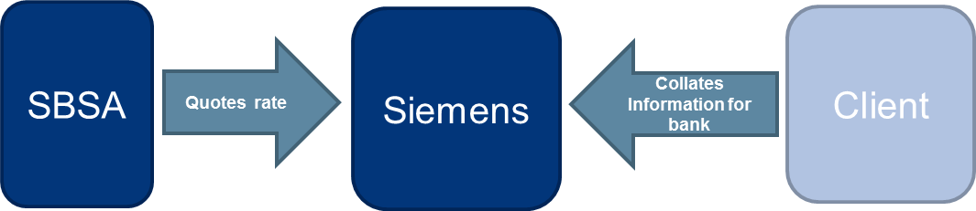
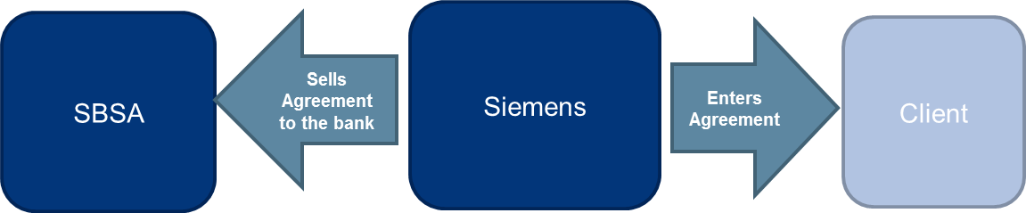
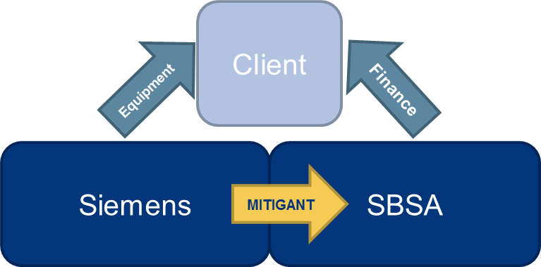
CST Client Strategy (Contd…)
4
VAF – Healthineers (Contd…)
Traditional Finance Partner
Agency Agreement
Benefits
Siemens is able to earn the rate spread for facilitating
Centralised credit set up for Siemens transactions
Dedicated resources within the bank
Benefits
Centralised credit set up for Siemens transactions
Dedicated resources within the bank
Shared Risk
FULL Recourse Discounting
Benefits
The bank is enabled to assist with marginal deals
Centralised credit set up for Siemens transactions
Dedicated resources within the bank
Benefits
Siemens makes the call on risk which enables fastest facilitation of sales
Siemens is quoted a rate on its individual risk grade which allows it earning a larger spread
This spread is paid upfront by the bank
This structure and facility will need to be approved for Siemens
Centralised credit set up for Siemens transactions
Dedicated resources within the bank

Slide 22
Conclusion
Relationship outlook
Standard Bank remains the main transactional and cash management Bank for Siemens in South Africa and other African regions with a treasury reporting line to South Africa
Other regions include Angola, Ghana, Kenya, Malawi, Mozambique, Namibia, Tanzania, Zambia, Zimbabwe
We have continued to support the client with their operations in Africa and have seen good growth in revenues on the back of increased transactional banking volumes and foreign exchange flows across the regions. Over the years, facilities availed to the Group have also increased steadily
Over the past few years, Siemens has undergone a wave of structural changes, which have resulted in a split of African operations as follows:
Siemens SA treasury team now has the added responsibility of managing additional regional offices from a governance and treasury perspective;
Angola and Mozambique now report into Siemens Portugal with Nigeria and other West African operations (except Ghana) reporting to the UK;
Egypt and neighboring operations report to Dubai while Cote d’Ivoire reports to Belgium.
The reorganization has brought about four resulting developments:
Increased pressure and workload on the Siemens SA treasury team;
New territories, and regulations for the Siemens SA team;
Increased volumes and facility requirements;
The need for fast turnaround and coordination from SBSA across the regions.
As a tier 1 client for the Power and Infrastructure sector, the Siemens relationship has been assigned a dedicated dual client service team in Europe (Udo-led) and South Africa (Jeannot-led), supported by the TPS Champions under the Global Transactional Banker model.
We are also trying to close the lag on IB opportunities with potential transactions in Uganda, Cote d’Ivoire and Namibia.
We are confident that we have the right teams and approach to retain our position as Siemens’ main banker
Standard Bank remains the main transactional and cash management Bank…
…Good growth in revenues on the back of increased transactional banking volumes and foreign exchange flows…
…Siemens relationship has been assigned a dedicated dual client service team in Europe and South Africa

Slide 23
Disclaimer
If you received this document in error, please immediately return the document and other related documents to Standard Bank.
On receipt of this document, you agree to be bound and are deemed to understand that:
This presentation is provided for information purposes only on the express understanding that the information contained herein will be regarded as strictly confidential. It is not to be delivered nor shall its contents be disclosed to anyone other than the entity to which it is being provided and its employees and shall not be reproduced or used, in whole or in part, for any purpose other than for the consideration of the financing or transaction described herein. If this presentation has been received in error it must be returned immediately to The Standard Bank of South Africa Limited (“Standard Bank”). This is a commercial communication. The information does not include a personal recommendation and does not constitute an offer, or the solicitation of an offer for the sale or purchase of any financial product, service, investment or security. The information, investments and/or strategies discussed here may not be suitable for all investors; if you have any doubts you should consult your investment advisor.
No liability is accepted by Standard Bank and/or any affiliate, subsidiary or branch thereof (the “Standard Bank Group”) whatsoever for any direct or consequential loss arising out of reliance upon all or any part of the information contained in this presentation. You are not relying on any communication (written or oral) from any member of the Standard Bank Group as investment advice or as a recommendation to enter into any transaction; it being understood that information and explanations related to the terms and conditions of a transaction shall not be considered investment advice or a recommendation to enter into that transaction. No communication (written or oral) received from any member of the Standard Bank Group shall be deemed to be an assurance or guarantee as to the expected results of that transaction. The investments discussed may fluctuate in price or value. Whilst every care has been taken in preparing this presentation, no member of the Standard Bank Group gives any representation, warranty or undertaking, express or implied, and accepts no responsibility or liability as to the accuracy, or completeness, of the information, statement, assumption or projection contained in this presentation. Past performance is not indicative of future results.
For the avoidance of doubt, our duties and responsibilities shall not include tax advisory, legal, regulatory accounting or other specialist or technical advice or services. You are to rely on your own independent appraisal of and investigations into all matters and things contemplated by this presentation. By accepting this presentation, you agree to be bound by the foregoing limitations. Kindly note that this presentation does not represent an offer of funding since any facility to be granted in terms of this presentation would be subject to the Standard Bank Group obtaining the requisite internal and external approvals.
This information is not intended for the use of retail clients and must not be acted on or relied on by persons who are retail clients. Any investment or investment activity to which this information relates is only available to persons other than retail clients and will be engaged in only with such persons. Standard Advisory London Limited (“Standard London”) is authorised and regulated by the UK Financial Conduct Authority. This presentation is for distribution in the UK only to, and is only intended to be directed at, persons within paragraphs 19(5) or 49(2) (a) to (d) of the Financial Services and Markets Act 2000 (Financial Promotion) Order 2005 (as amended). Persons into whose possession this information comes are required by Standard London to inform them about and to observe these restrictions. Telephone calls may be recorded for quality and regulatory purposes. Standard Advisory London Limited, 20 Gresham Street, London, EC2V 7JE.
Copyright 2015 Standard Bank Group. All rights reserved.

